Slide 1

Agency Update:
Utah State Parks
By: James Wells
Park Ranger
Dead Horse Point S.P.
Moab, Utah

Slide 2
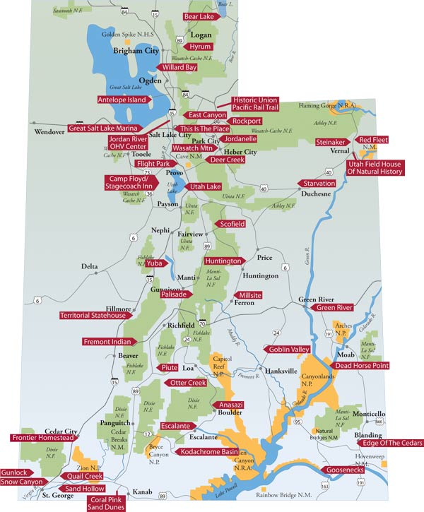
Utah’s 43
State Parks
5.2 million visitors in FY 2016 (July ‘15 – July ‘16)

Slide 3
Agency Mission: To enhance the quality of life by preserving and providing natural, cultural, and recreational resources for the enjoyment, education, and inspiration of this and future generations.
Director Fred Hayes: “more people having more fun in more parks more often…. we are working to find ways to draw more people by offering a greater diversity of ways to enjoy the parks.”

Slide 4
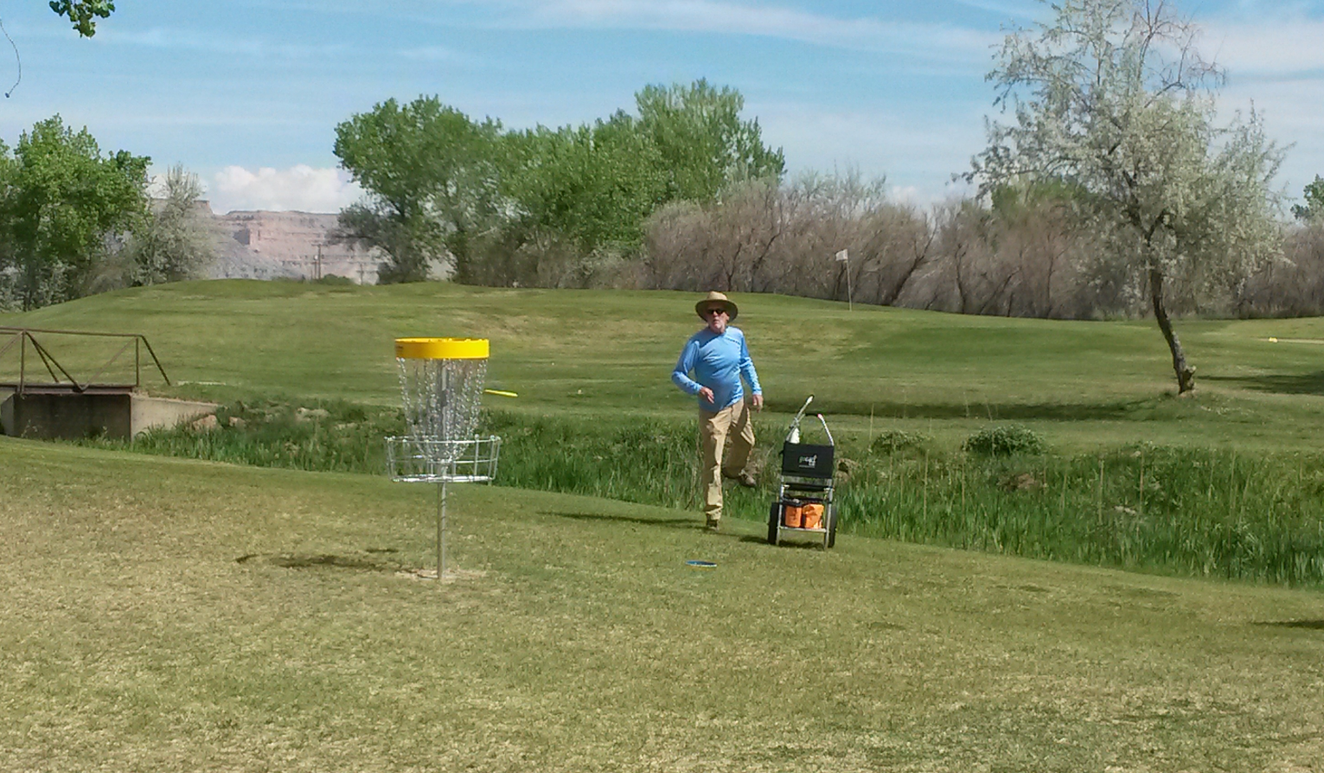
Green River State Park – Championship level, 18-hole disc golf course opened in 2015

Slide 5
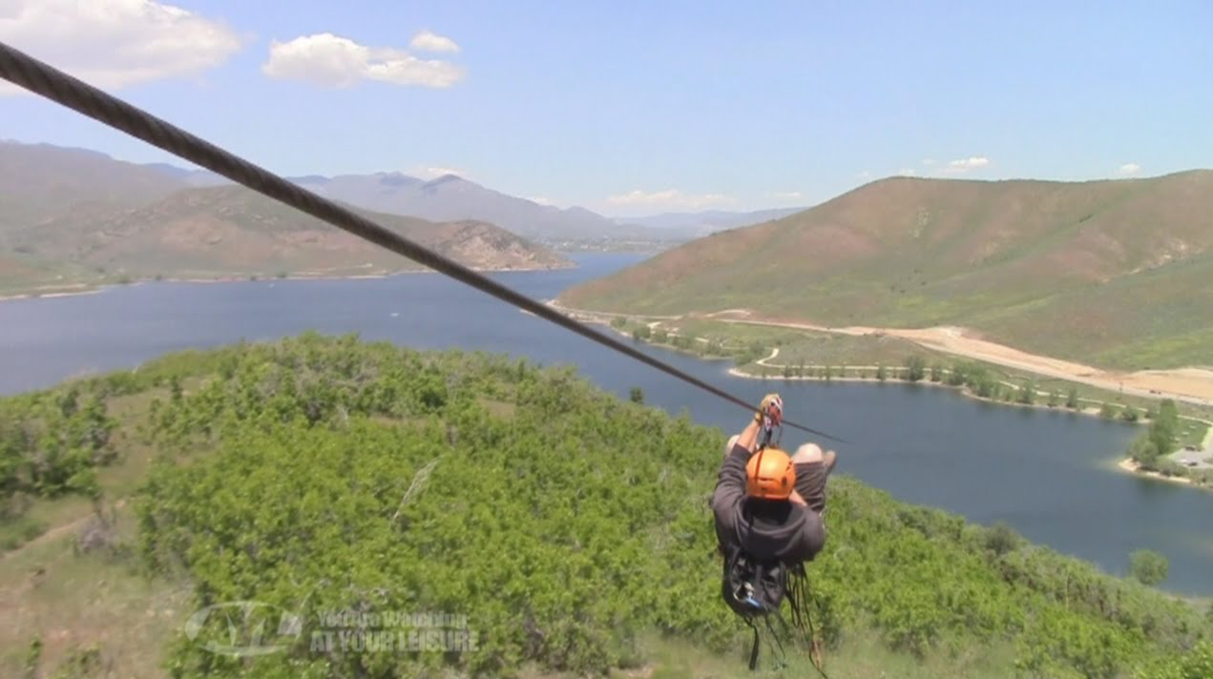
Zipline at Deer Creek State Park
Installed Spring 2016
World’s longest zipline running over water

Slide 6
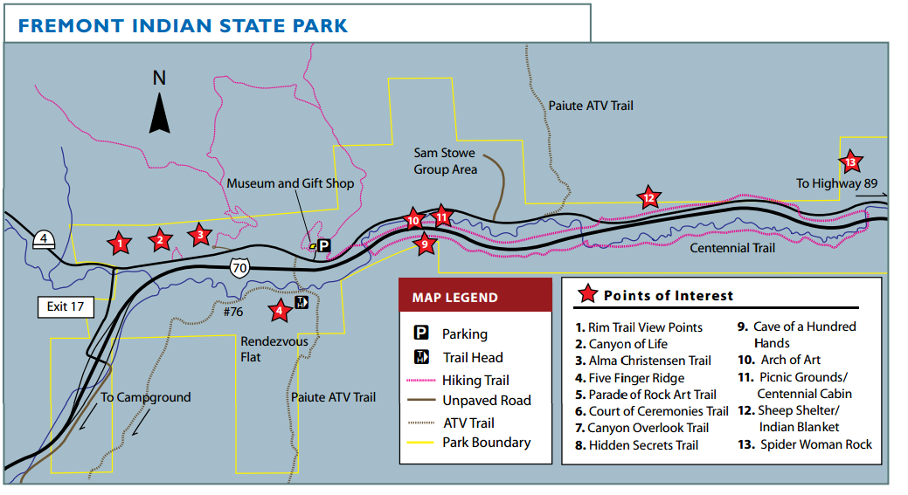
Fremont Indian State Park – Recently linked with the Piute ATV Trail network.
- Longest atv/ohv trail system in the world, at nearly 1,000 miles.

Slide 7

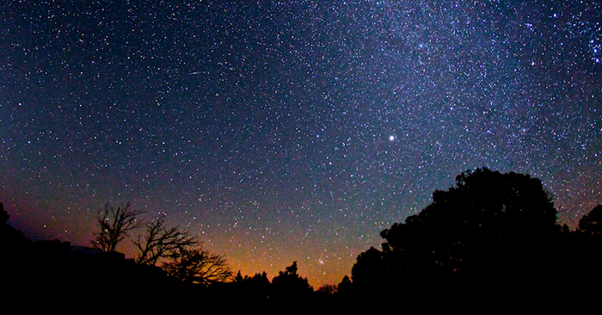

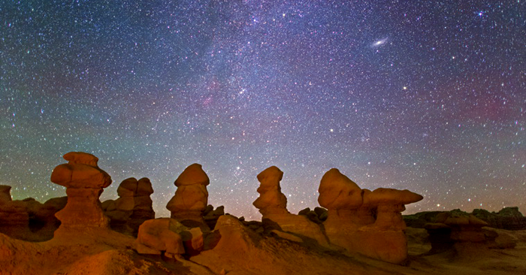
Two International Dark Sky Parks designated in 2016.
Ten additional parks seeking the designation.

Slide 8

International Dark Sky Parks…
Possess some of the clearest, darkest night skies in the world.
  Measured by light meter and photographic equipment
  Gold, silver, and bronze designations
Take measures to protect their own night sky.
  Shielding of light fixtures
  Light curfews & sensors
  Best Management Plans
Receive community letters of support for the designation.
Engage visitors with educational events.
  At least four events per year

Slide 9
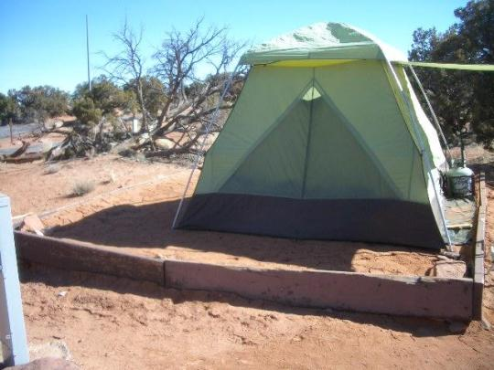
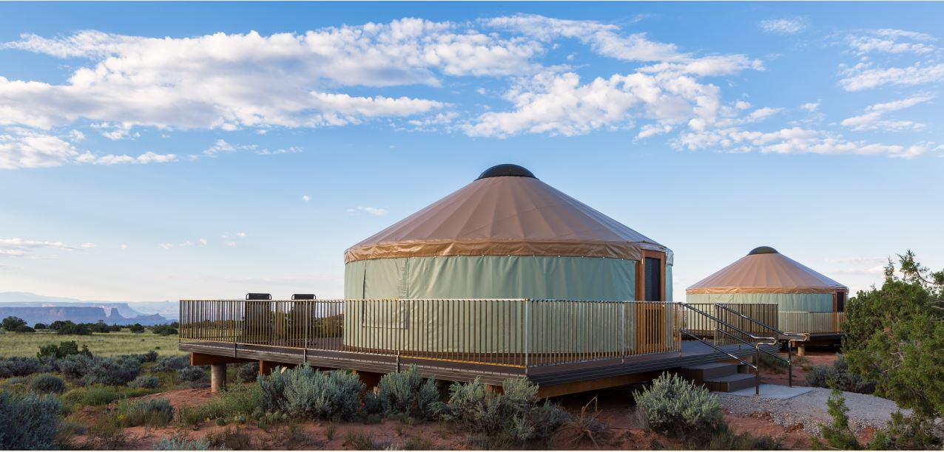
Plans for 2017: Campground expansion at Dead Horse Point State Park

Slide 10

Marina expansion at Bear Lake State Park

Slide 11
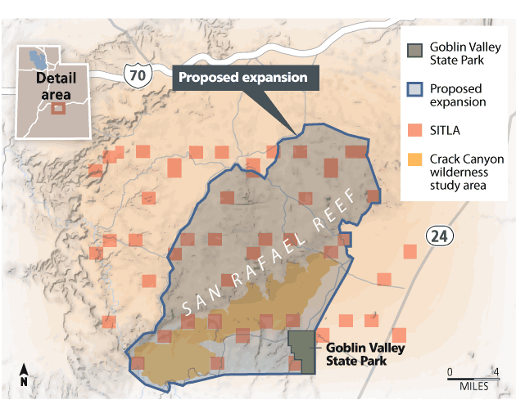
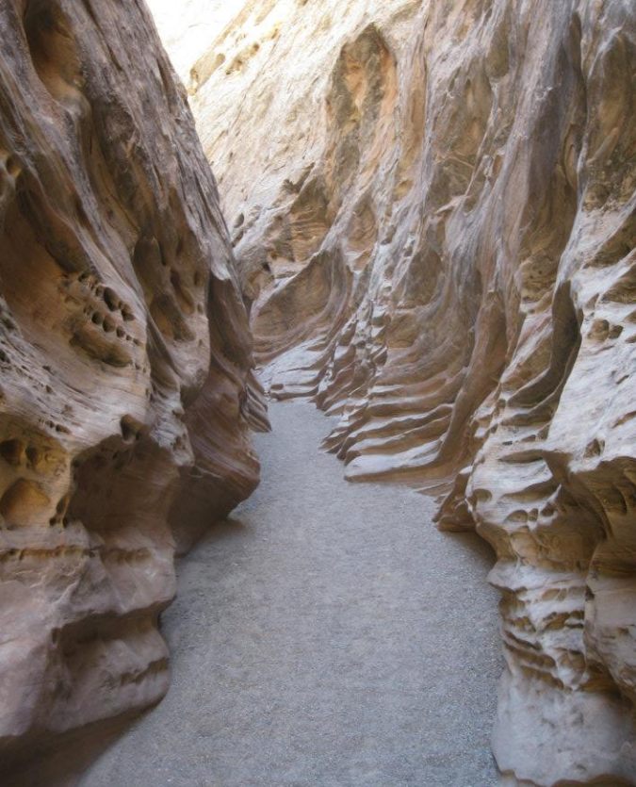
State-Federal land sharing agreements: Goblin Valley State Park
Map courtesy of the Salt Lake Tribune

Slide 12
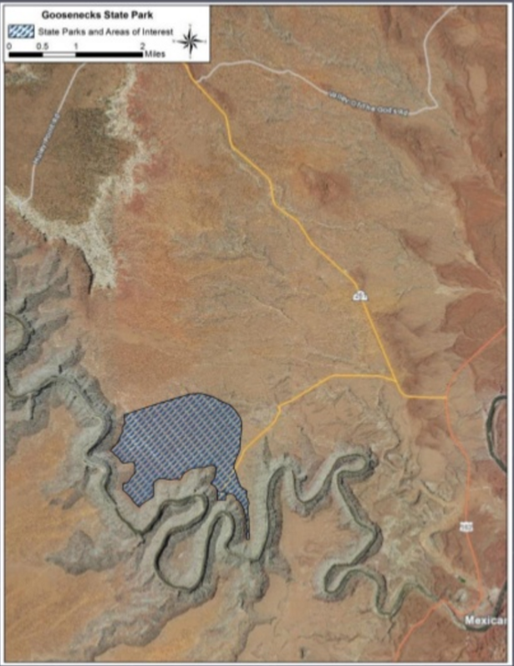
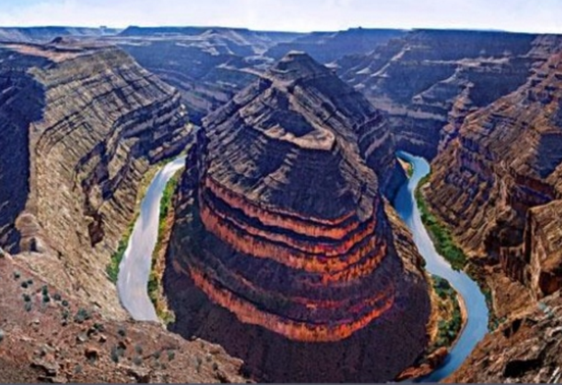
State-Federal land sharing agreements: Goosenecks State Park

Slide 13
60th Anniversary
1957-2017
60 special events to be held
  At least one per week
  One per park, regional office, and program office (Boating, OHV, etc.)
Fee Free Days
Commemorative souvenirs

Slide 14
With so many ongoing projects, there is near-constant demand for volunteer (and Eagle Scout) projects.
For those wanting to start a career in the parks, internships and paid seasonal ranger positions are posted during winter and early spring.
To learn more about either opportunity, it is best to contact park managers directly.
http://stateparks.utah.gov

Slide 15
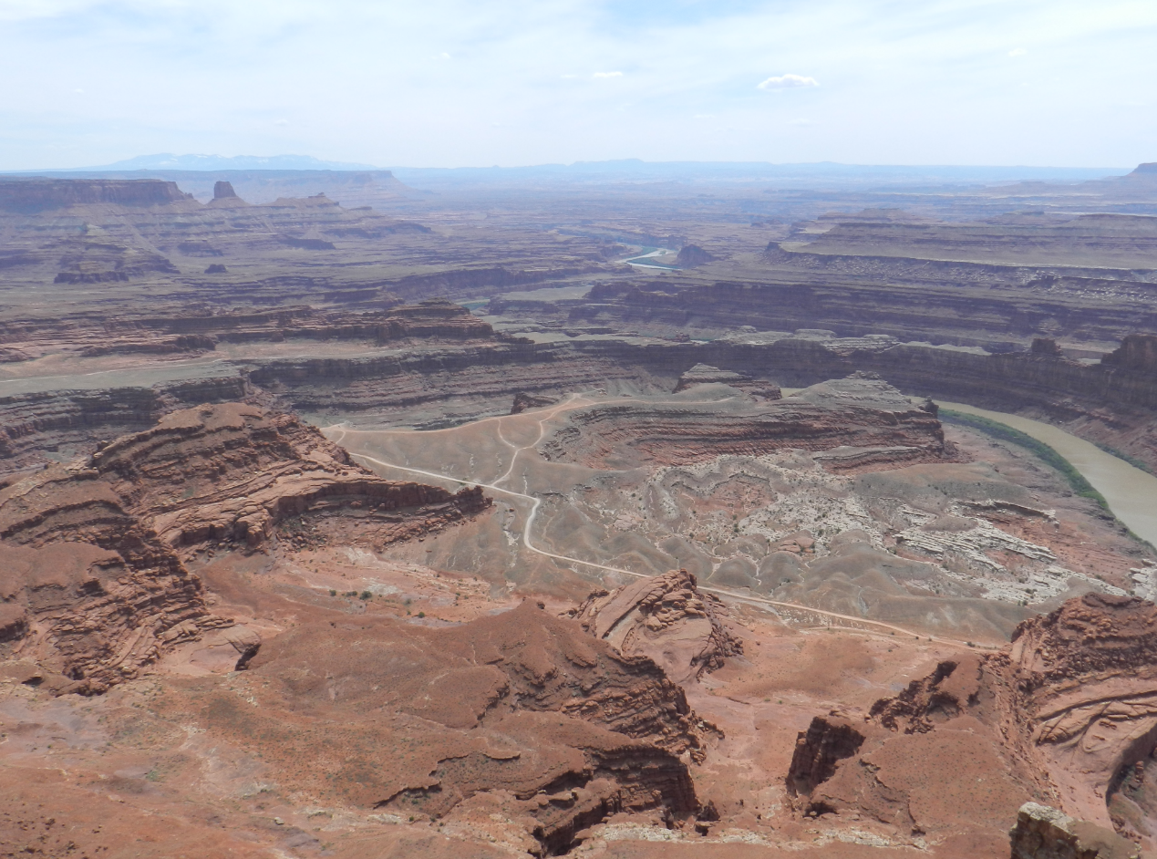
Questions?

