Slide 1
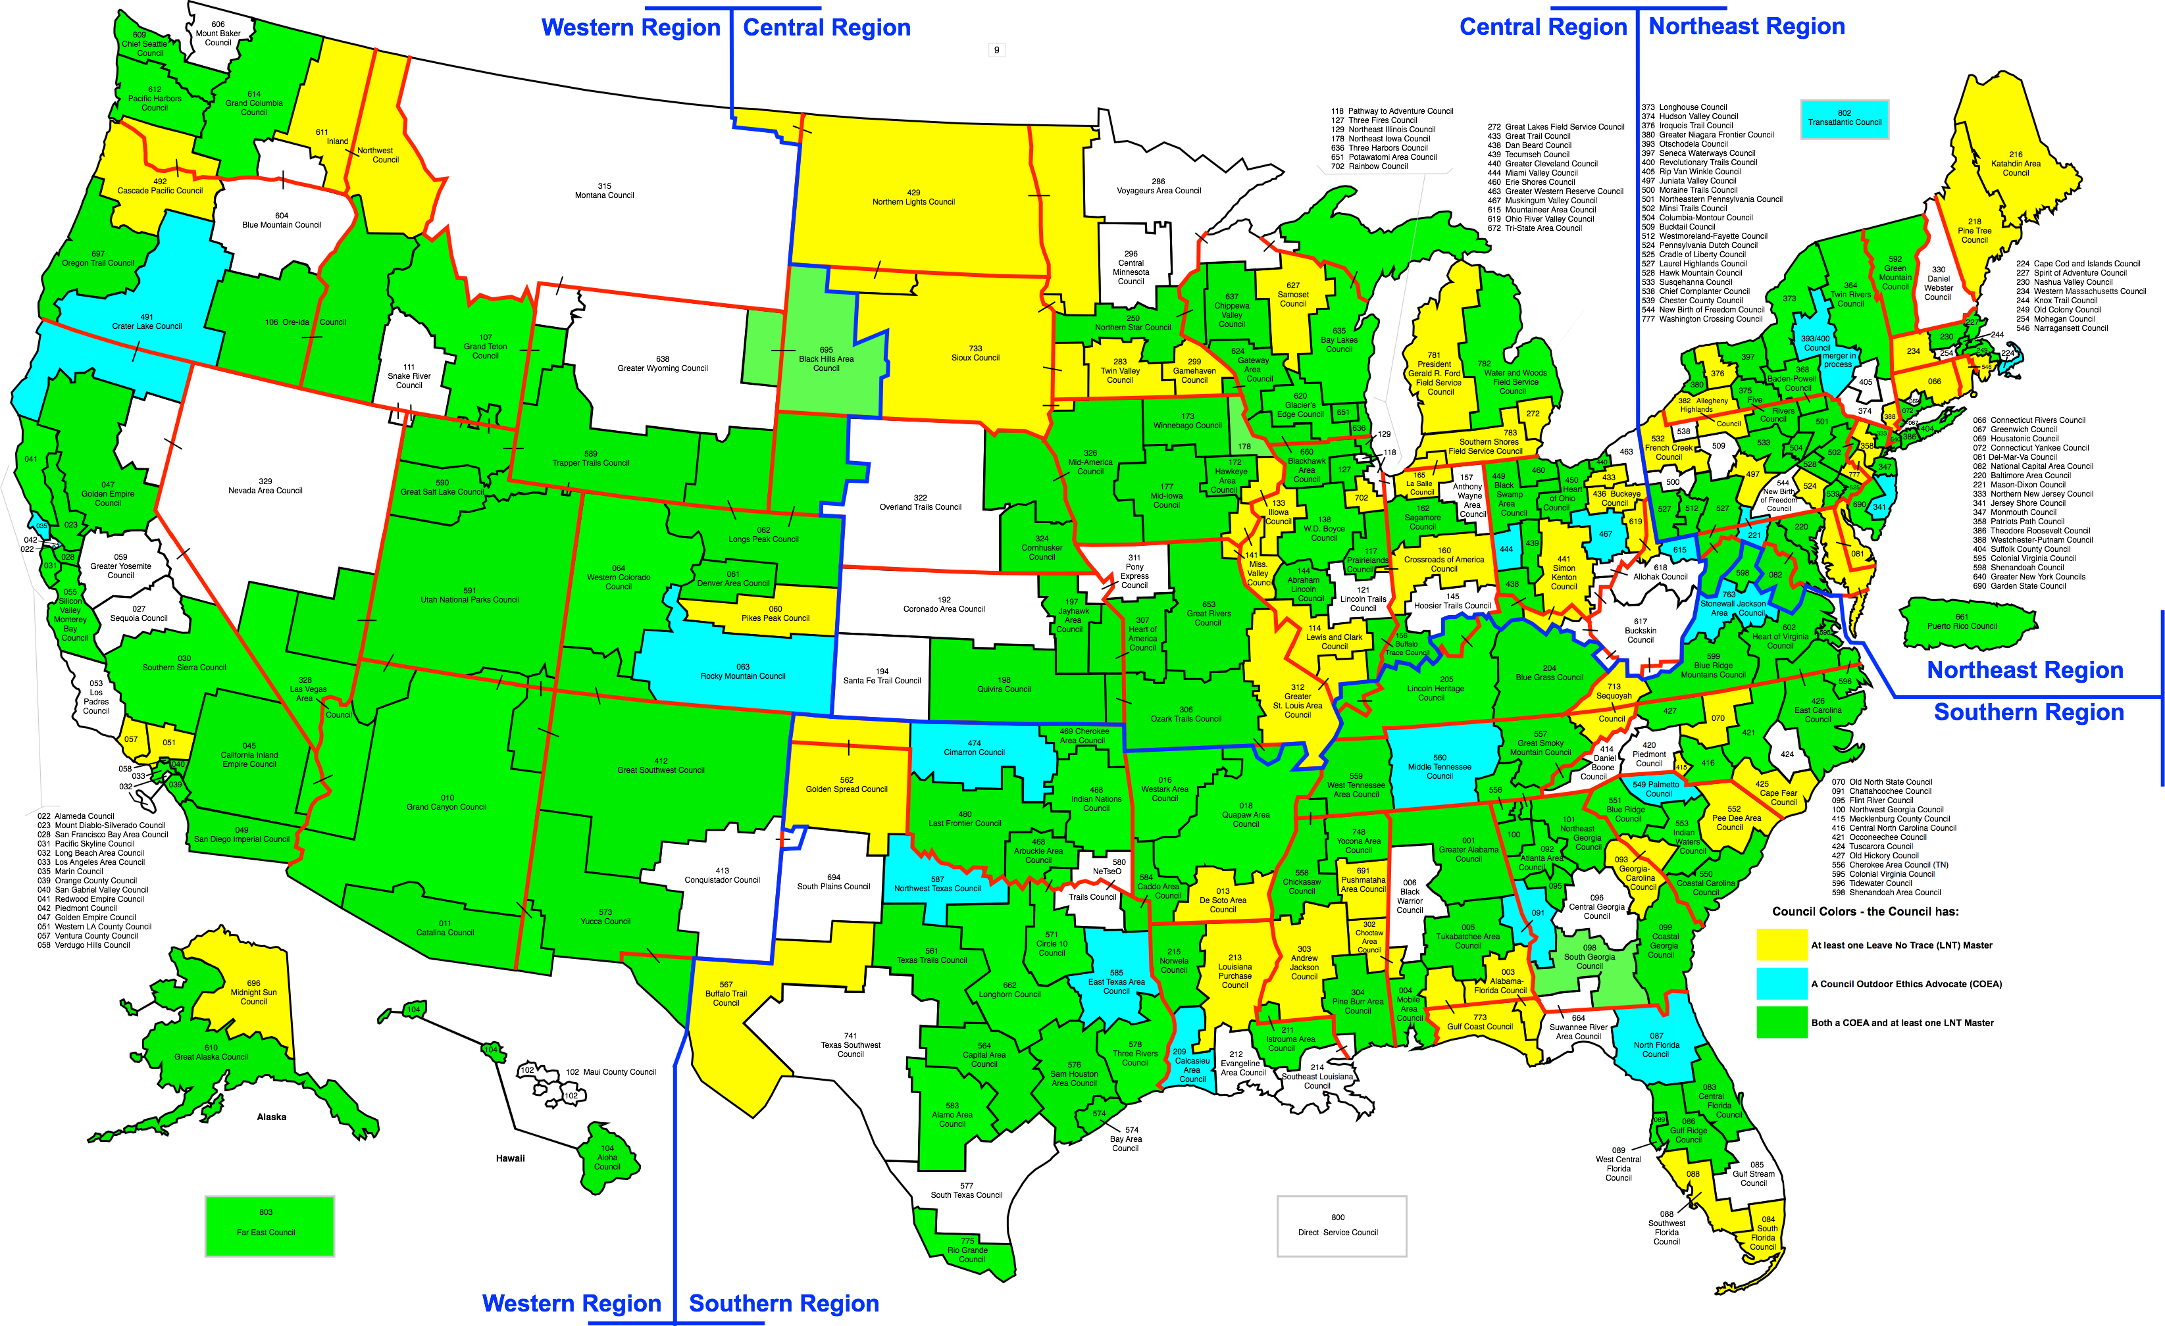
Scouting Leave No Trace Training Opportunities

Slide 2

Scouting Leave No Trace Training Opportunities
Scouting LNT Awareness Session
Any length
Any audience
Scouting LNT Workshop
• 3-4 hours
Scouting LNT Trainer Course
• 17-20 hours
• Usually on a weekend
Scouting LNT Master Educator Course
• Five days in length
• Two weekends or week-long
• Trek or non-trek format

Slide 3
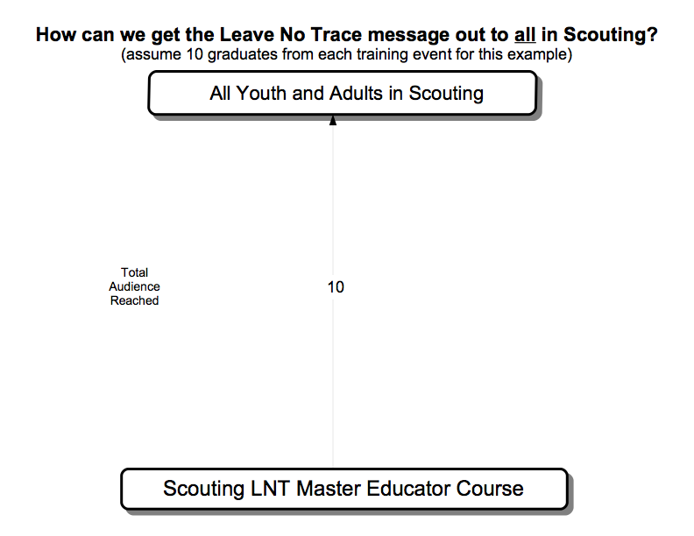
BSA Leave No Trace Training Opportunities

Slide 4
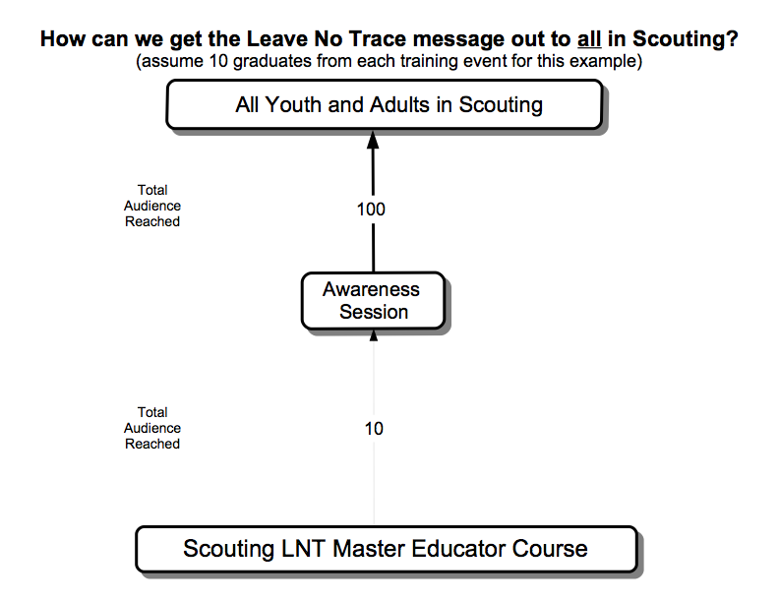
BSA Leave No Trace Training Opportunities

Slide 5
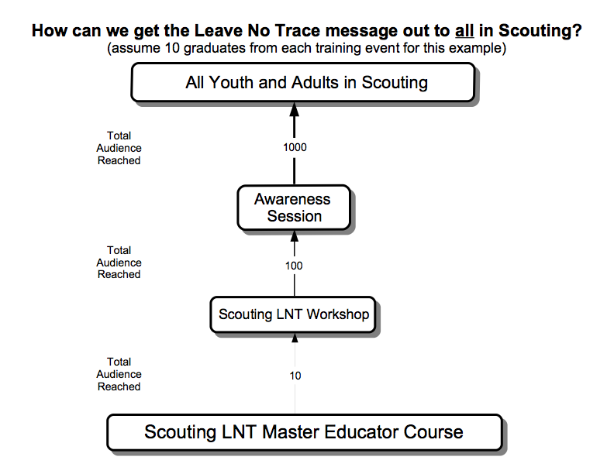
Scouting Leave No Trace Training Opportunities

Slide 6
