Slide 1
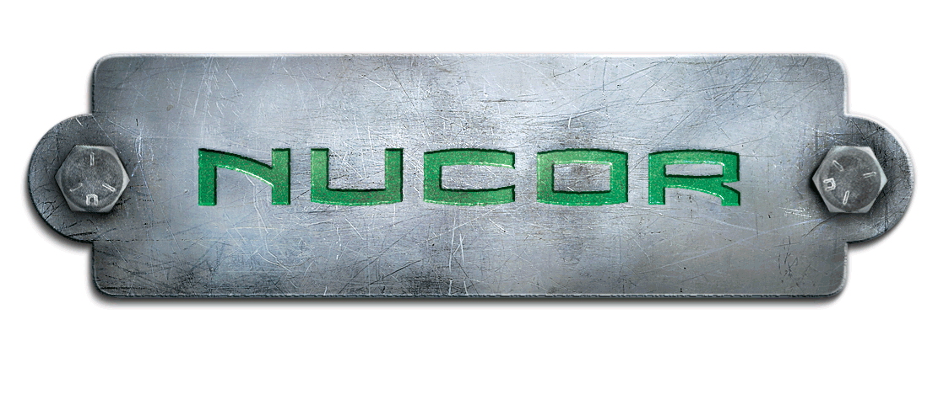
Management of Change System
Nucor Steel Auburn, Inc.
Eric Hiser
Jorden Bischoff & Hiser

Slide 2
Why Management of Change
(MOC)?
Unmanaged change = Unintended consequence
Managed change = Increased success

Slide 3
Unmanaged Change
Law of Unintended Consequences Applies
  Safety: NS-TX Drinking Water
  Compliance: V-AL Moving Equipment
  Environmental: NS-AR Evacuation to atmosphere
  Quality: NS-Memphis caster speed
  Cost: All of the above
MOC Increases Likelihood that Unexpected Issues Will Be Caught

Slide 4
MOC Purpose
The Management of Change Process is used to communicate changes within the division to minimize Unintended Consequences.
The Management of Change Request must be approved prior to the change taking place. For example: before a new chemical arrives on site, before new equipment is installed.
  For major construction or equipment modifications, an MOC request should be submitted early in the planning stages due to the lead time needed for obtaining an air permit modification.

Slide 5
MOC Process
The MOC process starts with the Project Leader.
  The project leader is the person responsible for pushing the project to see if it should be completed.
Project Leader needs to:
  Identify the need for change and how the change addresses the need
  Identify the process, operational, quality, safety and environmental aspects of the proposed change
  Identify tentative resolutions to these issues
  Safety, Quality and Environmental are resources to assist at this stage

Slide 6
MOC Process
The Management of Change Request system forms can be obtained from the Nucor Steel Auburn portal.
For Chemical Change Requests an MSDS must be submitted to the Environmental Dept.
For Process Changes any associated drawings or other documents helpful to understanding the proposed change should be submitted to the Environmental Dept.

Slide 7
MOC Process
Your Department evaluates the proposed change and its process and quality implications and whether it should be recommended
  Some projects may end at this stage
If approved at Departmental level, next steps:
  The Safety Coordinator reviews the change to ensure that safety concerns are addressed
  The Environmental Department reviews the change so they can ensure proper permits are obtained, regulations are complied with and environmental impacts are minimized
  Quality could also be integrated

Slide 8
MOC Drivers
Safety and Environmental Issues Often Drive MOC Review
  Safety
    Is the proposed chemical or product safe for its intended use? If not, what steps must be taken?
    Is the proposed chemical or product safe for others in its intended use? If not, what steps must be taken?
    Are there side effects? If yes, how eliminate?
    Is the proposed chemical or product compliant with applicable OSHA, ANSI and other standards? If not, what steps must be taken?

Slide 9
MOC Drivers
Environmental Drivers
  Air
    A variation from a permit representation or condition may require permit action
    Any work on an emission unit or that may affect an emission unit that is not “routine” maintenance, repair and replacement of components. The following changes are rarely, if ever, “routine”:
      A change that will make an emission unit run hotter, longer, faster, greater quantity or harder than it presently can do;
      A change that will eliminate currently unavoidable “down time”;
      A change that will restore capacity that we have let degrade over time; or
      A change that will let a unit run or last longer than it currently can.
    Basic rule: if the unit can’t do it now, it shouldn’t be able to do it after the change unless you have run the change through management of change.

Slide 10
MOC Drivers
Environmental
  Water
    Addition of any water or other substance to any storm water ditch at the plant (NPDES permit issue)
    Addition of any water or other substance into any pond or hole (Land Application Permit/UIC issue)
    Changing any chemical that is added to the water system, either directly (water treatment) or indirectly (hosed into flume)
    Changing any permanent piping or connecting a new pipe or hose to piping other than at designated points for designated purposes

Slide 11
MOC Drivers
Waste
  Creating any new waste that will require disposal
Hazard Control
  Bringing in any new chemical or changing the use of a previously approved chemical
  Bringing in any new radioactive or x-ray equipment
  New tanks/containers

Slide 12
MOC Outcomes
MOC Review System is Being Revised, But Will Result in Following:
  MOC Approval: project may proceed.
  MOC Permit Hold: Environmental will work with project leader to obtain necessary permits/approvals.
  MOC Disapproval: MOC not approved and Environmental will work with project leader on possible alternatives.

Slide 13
MOC Examples
New temporary cooling tower for the EAF duct work
Change EAF burners to compressed air
Building expansion—extending foot print of an existing building
Moving a gasoline tank
Replacing chains with magnets

