Slide 1
Feminine Hygiene in the Backcountry

Slide 2
Concerns and Impacts
Health and Safety
Environmental Impacts
Personal Relationship to the Outdoors

Slide 3
Teaching
Separate males and females
Professional, technical, biological
Be proactive
Never call out individuals
Learn about and share a wide variety of options

Slide 4
Hygiene Kit
Opaque stuff sack
Ziplock baggies
Ample pads and tampons
Bandana/Pee Rag
Hydration bladders

Slide 5
On the Trail
Provide time dedicated specifically for washing
No competing program or activities
Provide clean water for washing
Hygiene and bodily functions take time that young people and women might feel uncomfortable claiming
Have a system for dealing with trash
Group vs Individual
Provide opportunities to get rid of trash in a nonthreatening way
Trash separate from food

Slide 6
Female Urination Devices (FUDs)
Convenience and confidence
Relieves social pressures that come with female urination
Not drinking to avoid urination
Avoiding defecation
Youth protection
Minimize risk of embarrassment
Side note – rain ponchos for privacy

Slide 7
Using a FUD
Sturdy, makes a good seal
Practice at home
Wide stance
Up, then back

Slide 8
Menstrual Products
Disposable Pads
Disposable Tampons
Reusable Pads
Sponges
Menstrual Cups

Slide 9
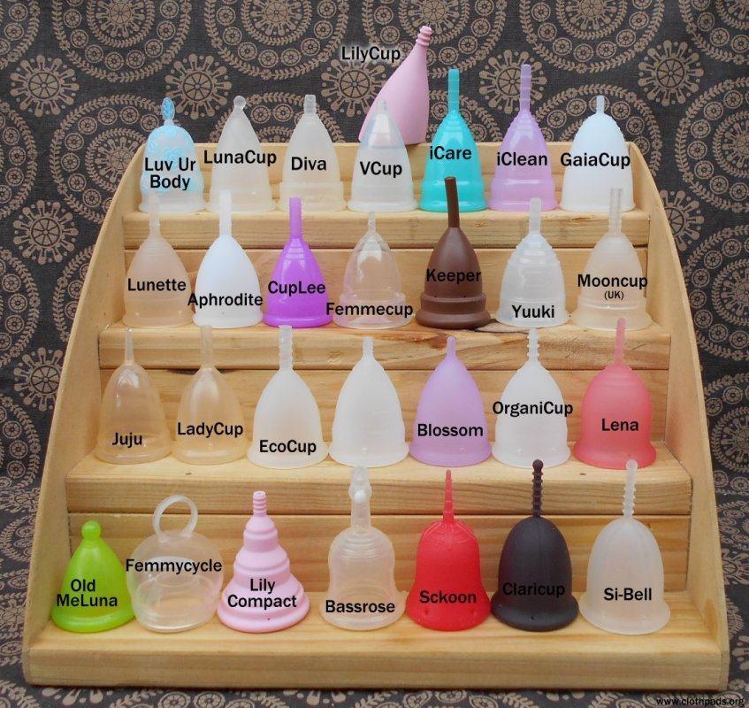

Slide 10
Pack Out vs Bury
Products
Pack it out, just like trash
Blood
Pack it out
Bury, just like feces
Used products and blood are a smellable and should be treated as such.

Slide 11
Minimize Packaging
Remove Wrappers and Applicators
Might make insertion painful, difficult, or even impossible
Hand washing
Reusable pads, sponges, and cups are the ultimate in minimal packaging
Require cleaning and drying

Slide 12
Bears
Smellable Status
Personal Safety
There is no evidence that black bears are attracted to menstrual fluid or menstruating women.

Slide 13
Personal Relationship to the Outdoors
Insecurities and lack of knowledge, skills, and products are common barriers keeping women from completely enjoying the outdoors.

Slide 14
Randa Kelton
randa.galbreath@gmail.com

