Slide 1

LNT With Pack & Saddle Stock
Craig Allen
LNT Master Educator
Utah State Advocate for LNT Outdoor Ethics

Slide 2
Horse Use and the Wildlands
Aldo Leopard used horses to define wilderness
“By ‘wilderness’ I mean a continuous stretch of country preserved in its natural state, open to lawful hunting and fishing big enough to absorb a two-week pack trip…”
Use of packstock is still a popular way to visit wildlands
Tradition is strong and also dynamic
New equipment and techniques reduce impact

Slide 3
Purpose
To acquaint LNT MEs and ME candidates from other user groups with pack and saddle stock LNT considerations so that they may respond to queries from equestrians during seminars, workshops, clinics etc.

Slide 4
Plan Ahead and Prepare
Where & when are you going?
What are the regulations?
Group size
Permits
Fire restrictions
Stock Containment restrictions
What is it like there?
Water
Graze
Topography
Weather
Options

Slide 5
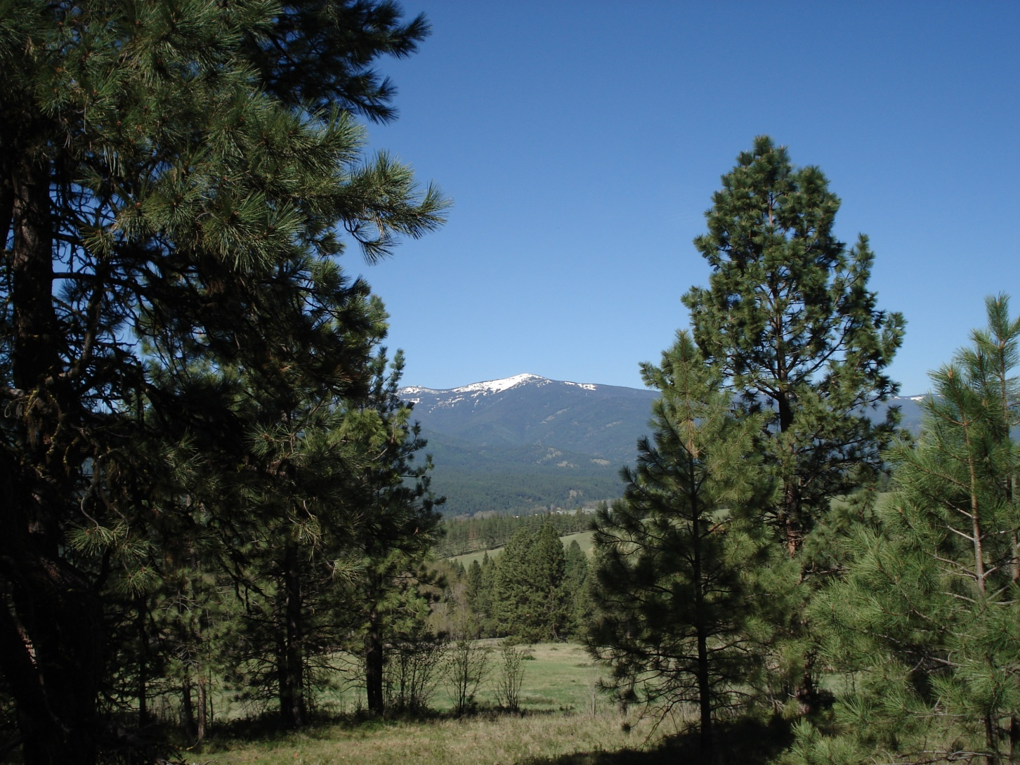
Where are you going?

Slide 6
Plan Ahead and Prepare
Gear
Yours
Animals
Know your animals
Trail is not training area
Know yourself and the members of your group
Take responsibility

Slide 7
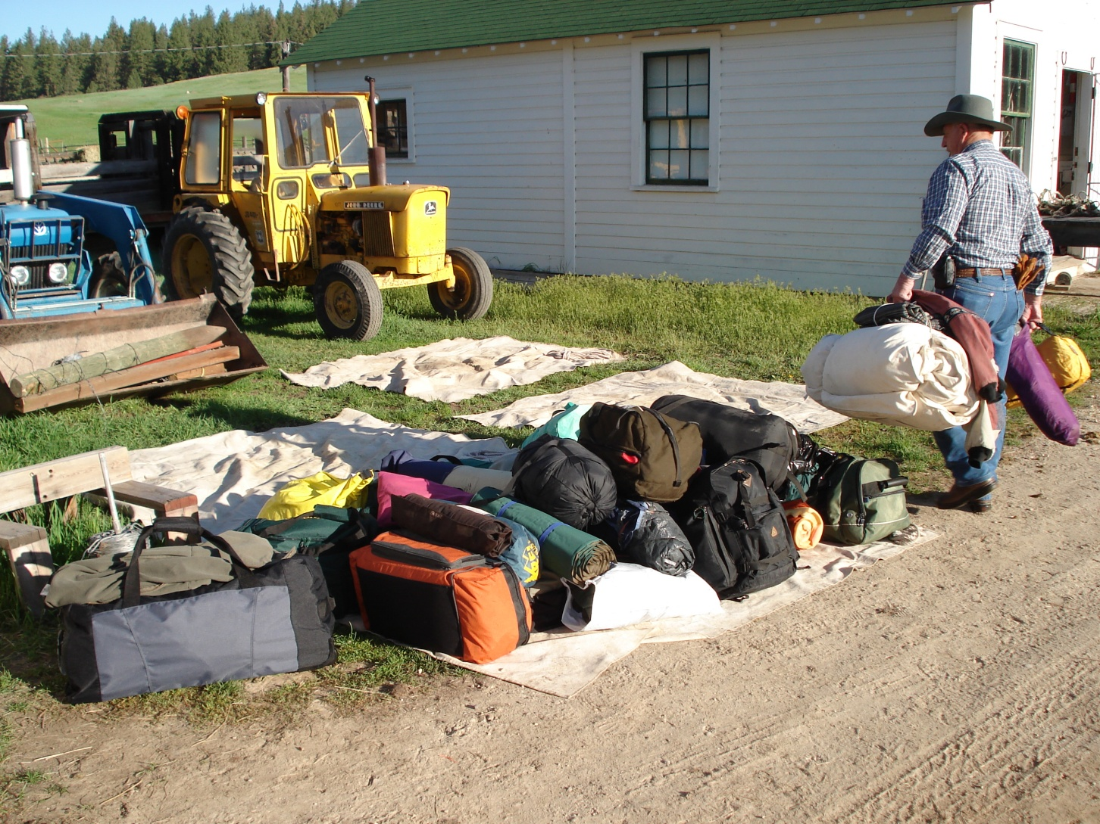
Your Gear

Slide 8
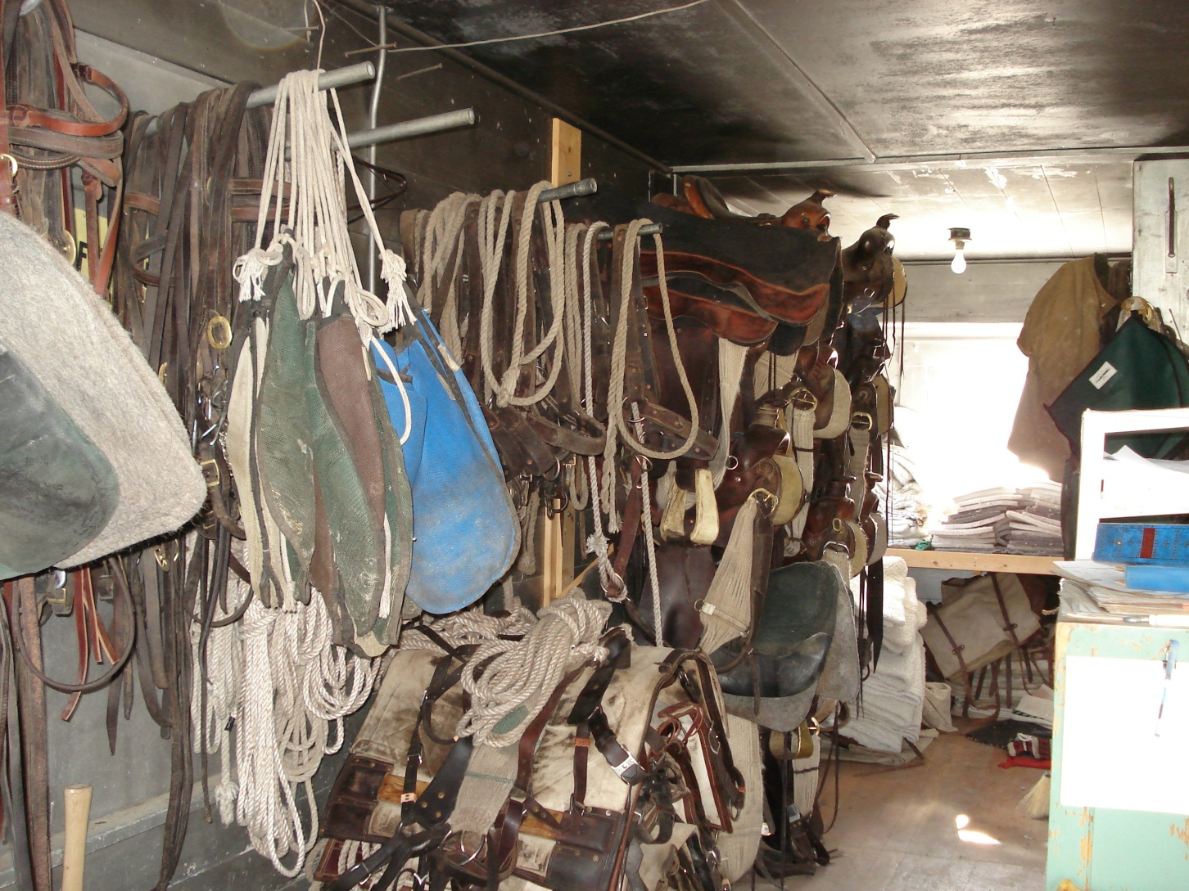
Horse Gear

Slide 9
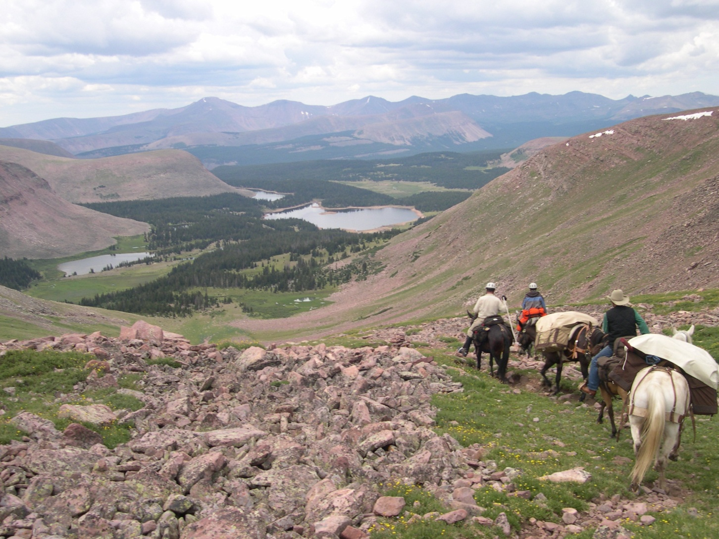
Prepare for Terrain

Slide 10
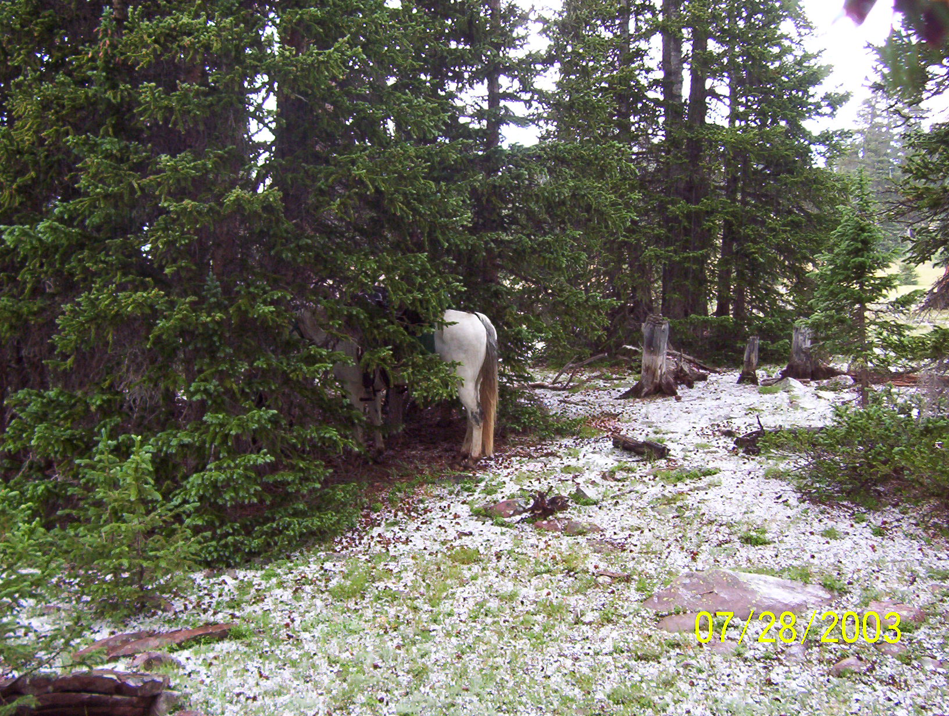
Weather?

Slide 11
Travel & Camp on Durable Surfaces
Use surfaces that are resistant to impact
Trails
Sand
Gravel
Dry grass
Mineral soils
Concentrate use in popular areas
Disperse use in pristine areas
Good camps are found not made

Slide 12
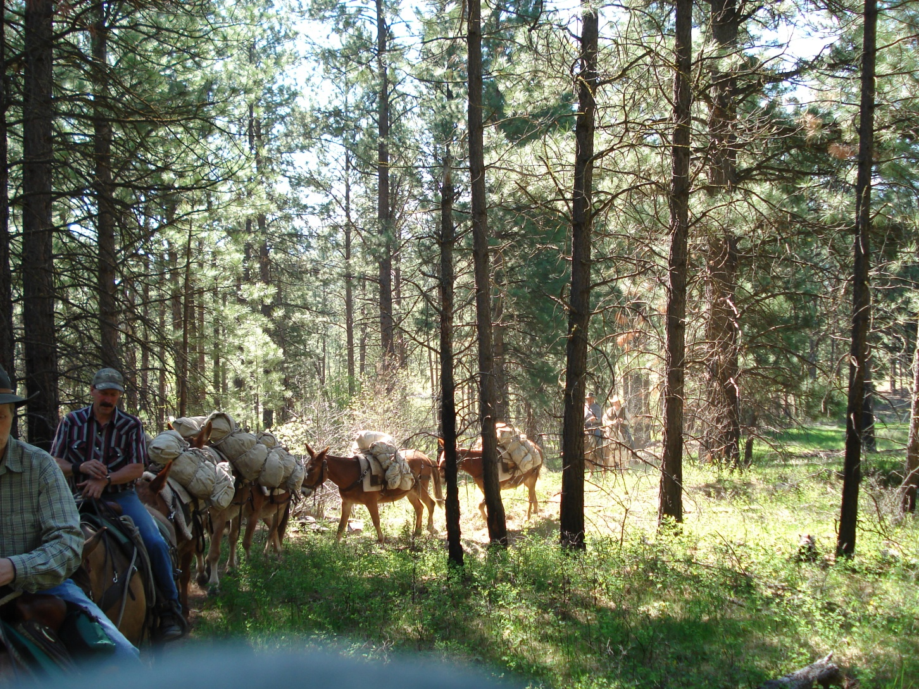
Stay on Trails

Slide 13
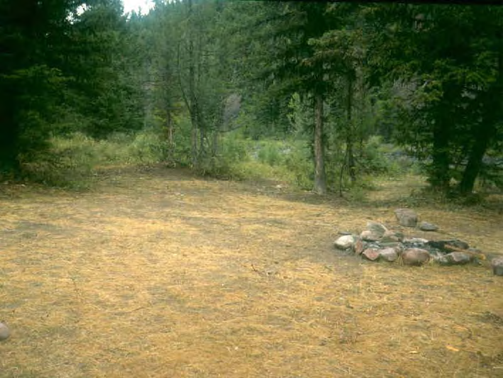
A Hardened Site

Slide 14
Stock Confinement
As big a site selection criteria as tent and kitchen
Methods
Hobbles
High Line
Picket
Corrals/fences
Loose
Watering & Feeding considerations
Breaking camp

Slide 15
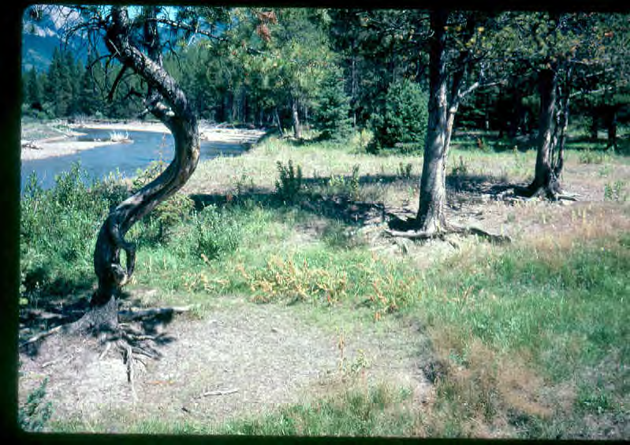
Do Not Tie to Trees

Slide 16
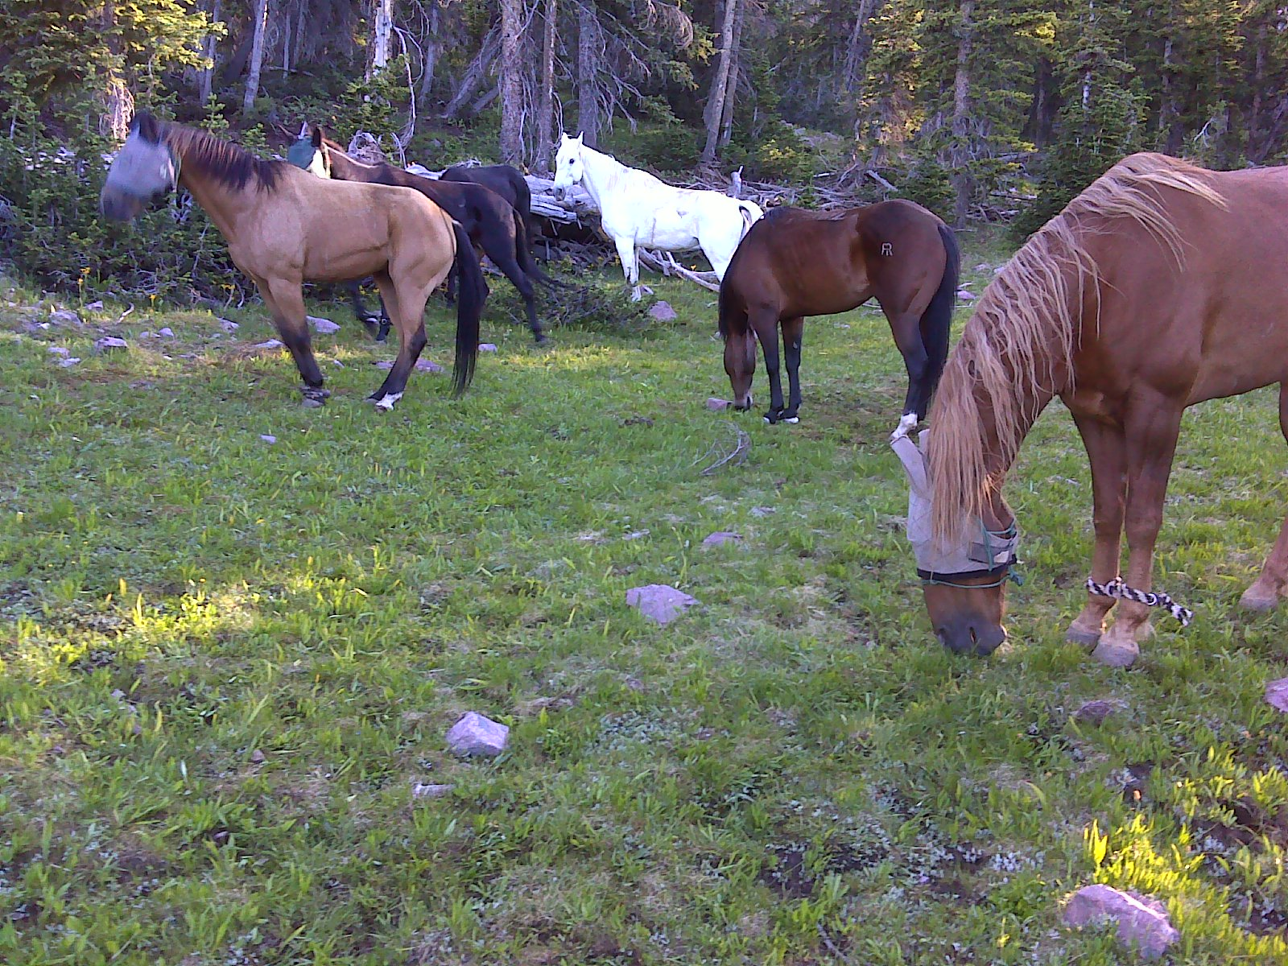
Hobbles

Slide 17
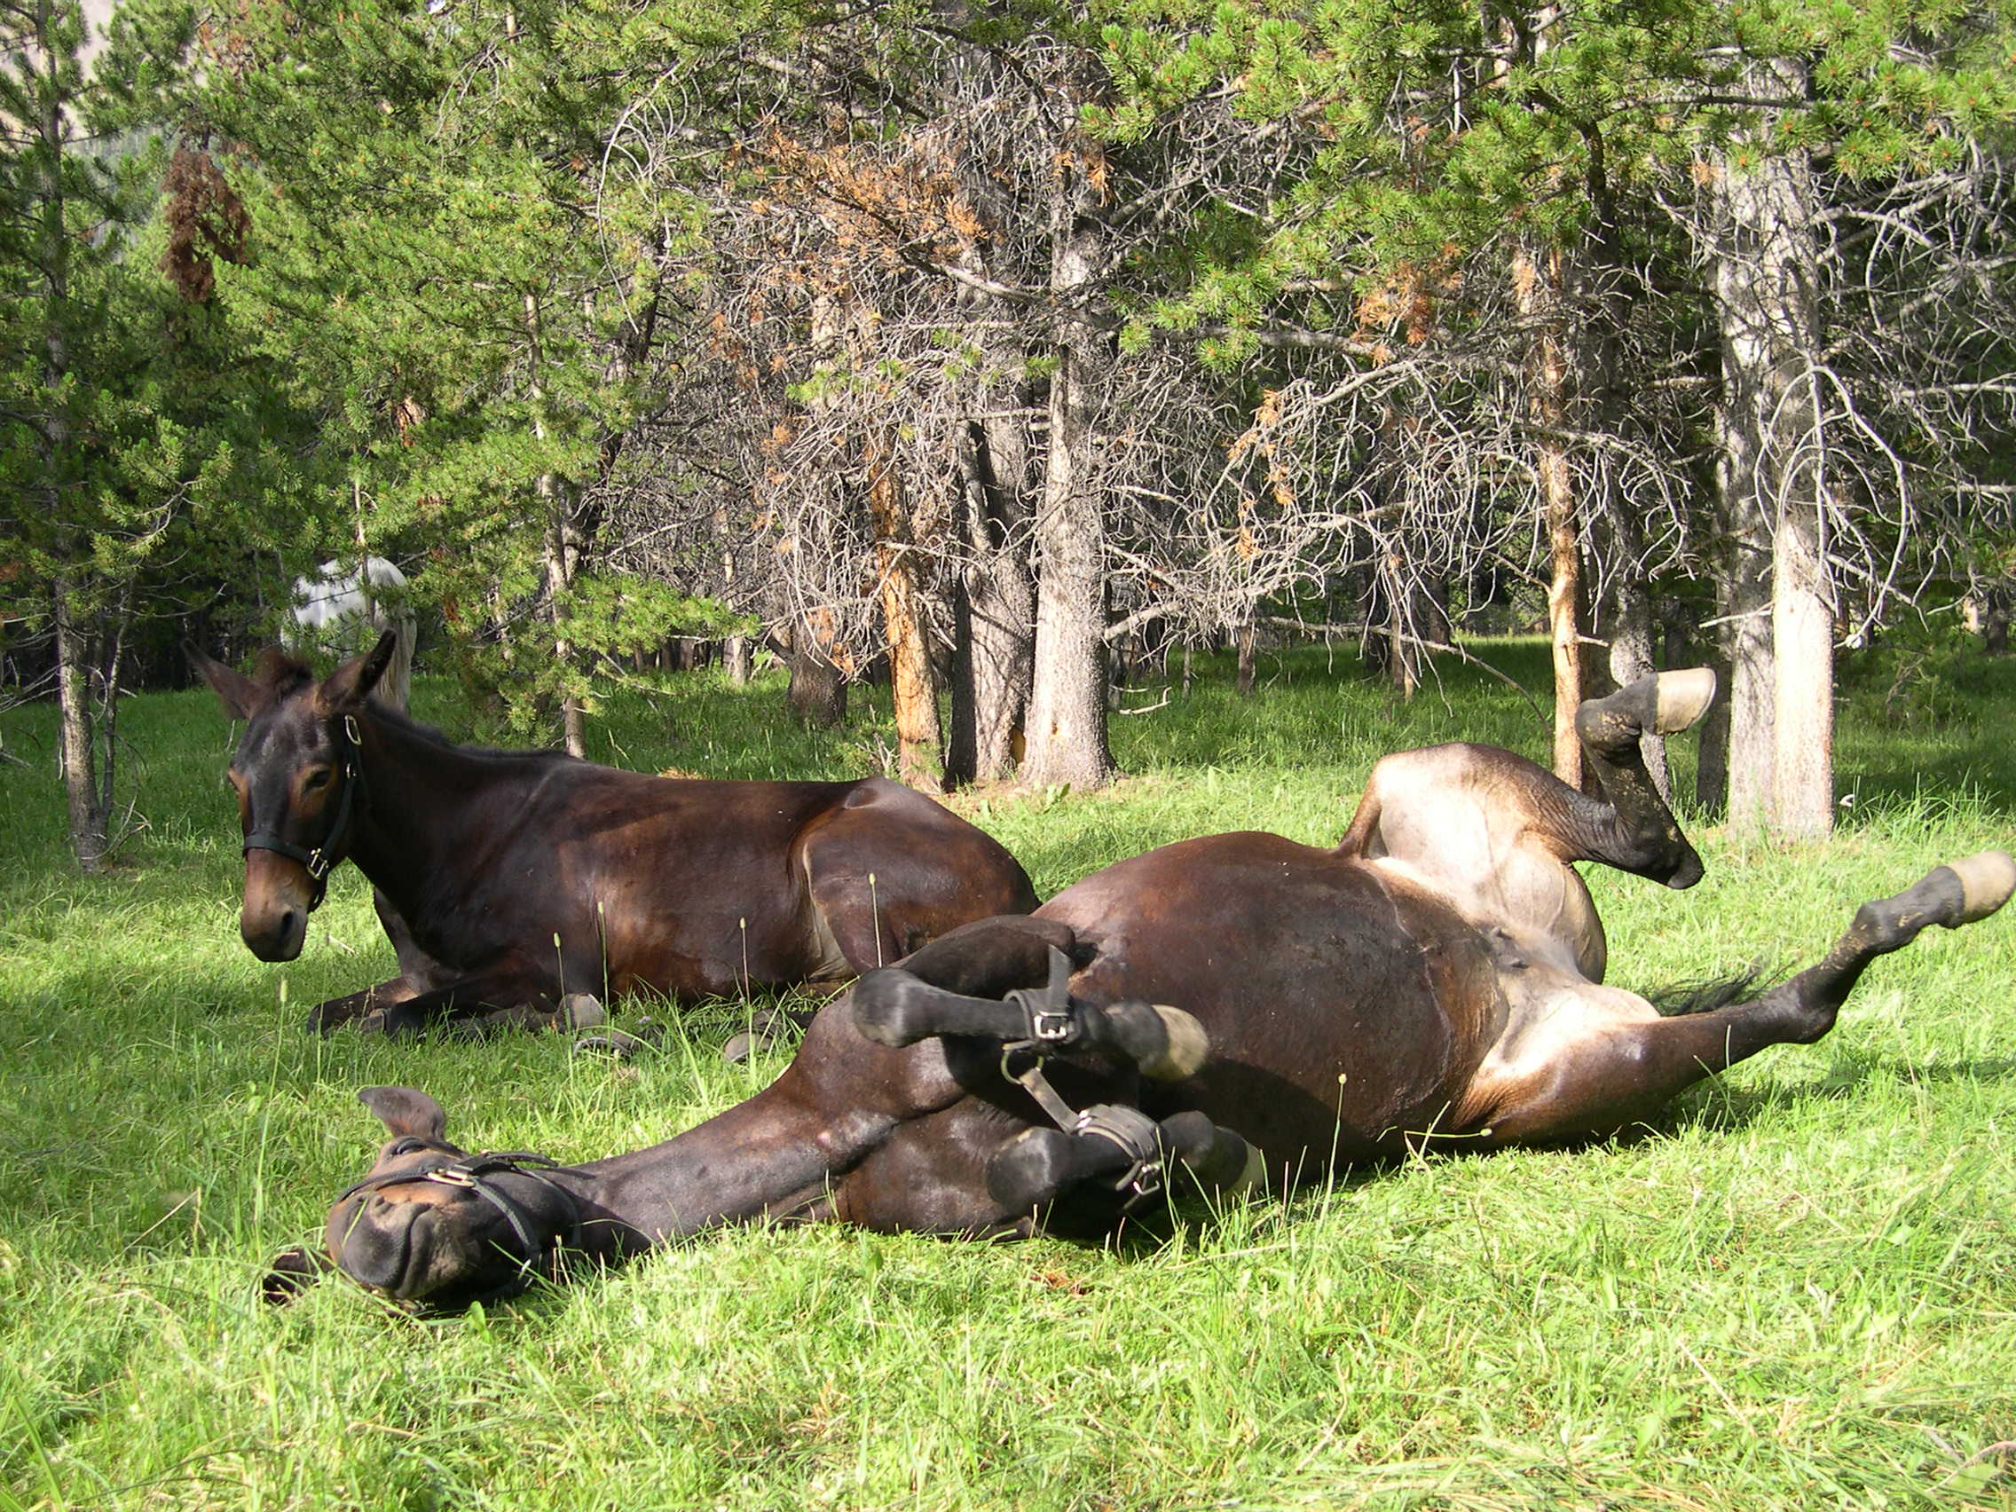
Hobbles

Slide 18
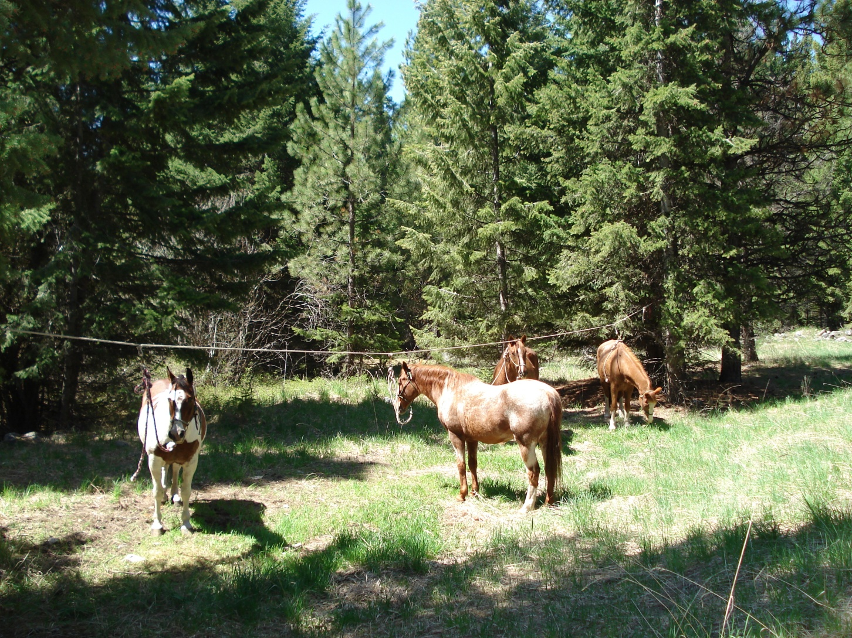
High Line

Slide 19
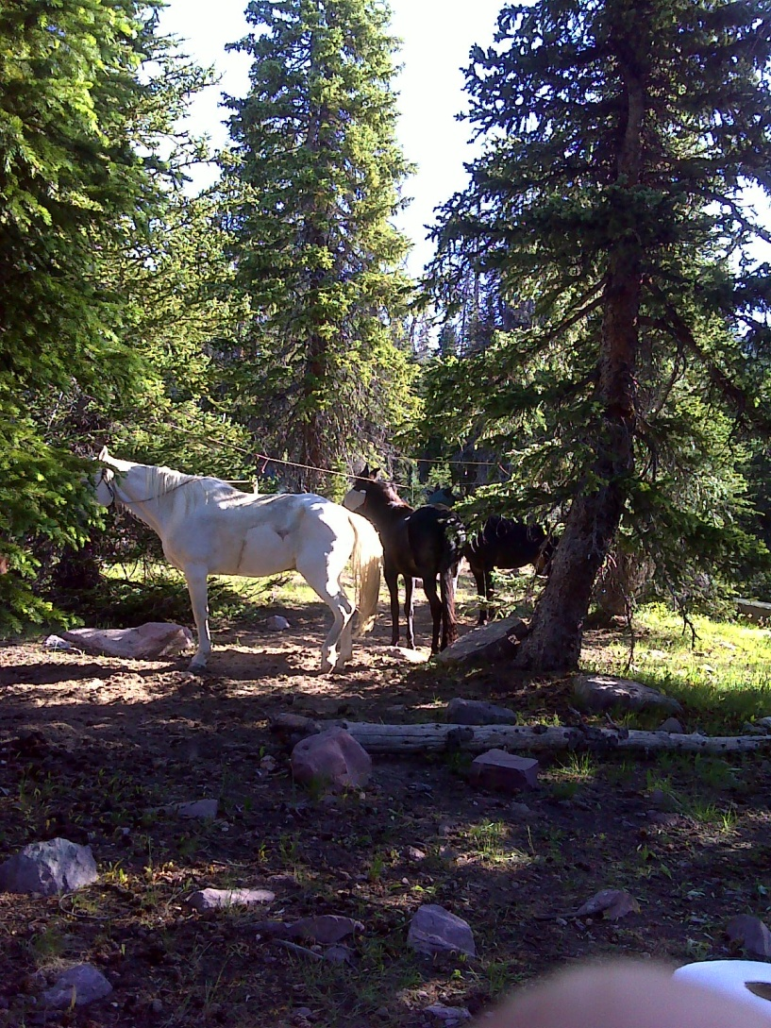
High Line

Slide 20
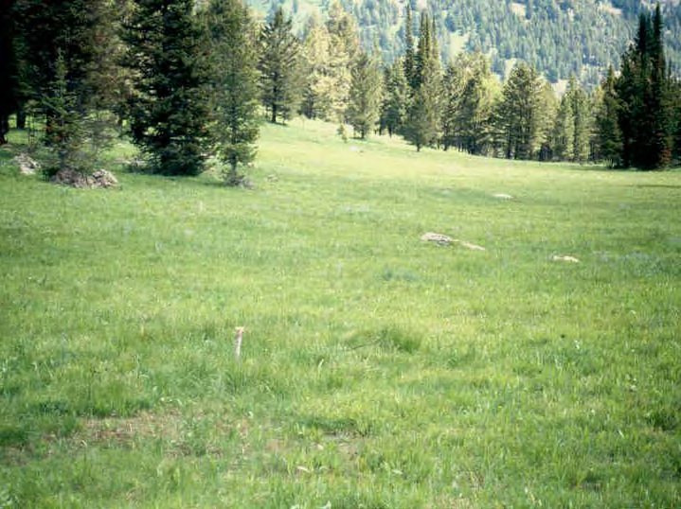
Picket (Concerns)

Slide 21
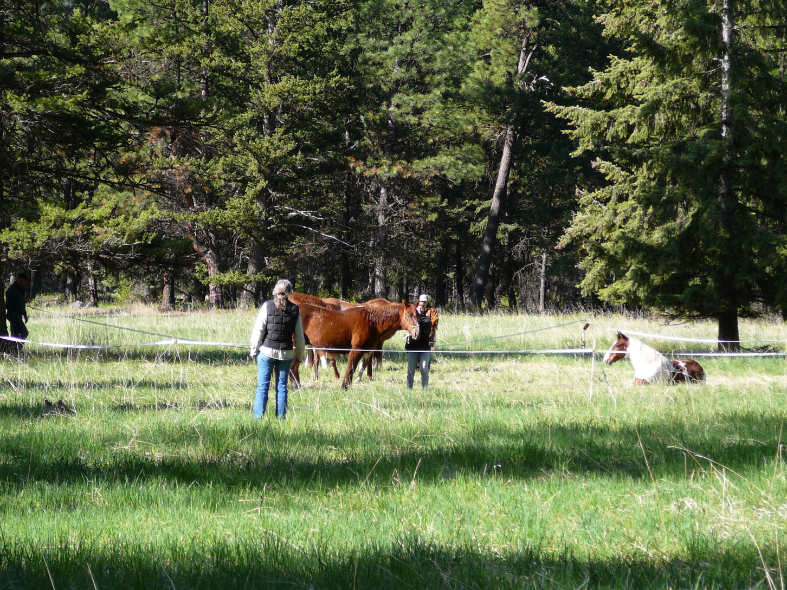
Electric Fence

Slide 22
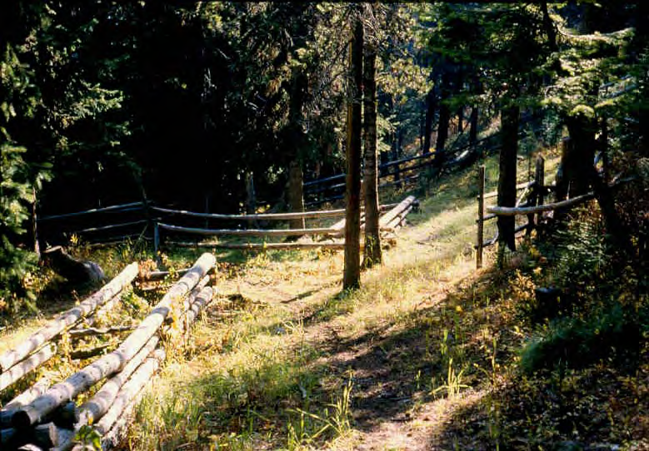
Corrals (Yikes!)

Slide 23
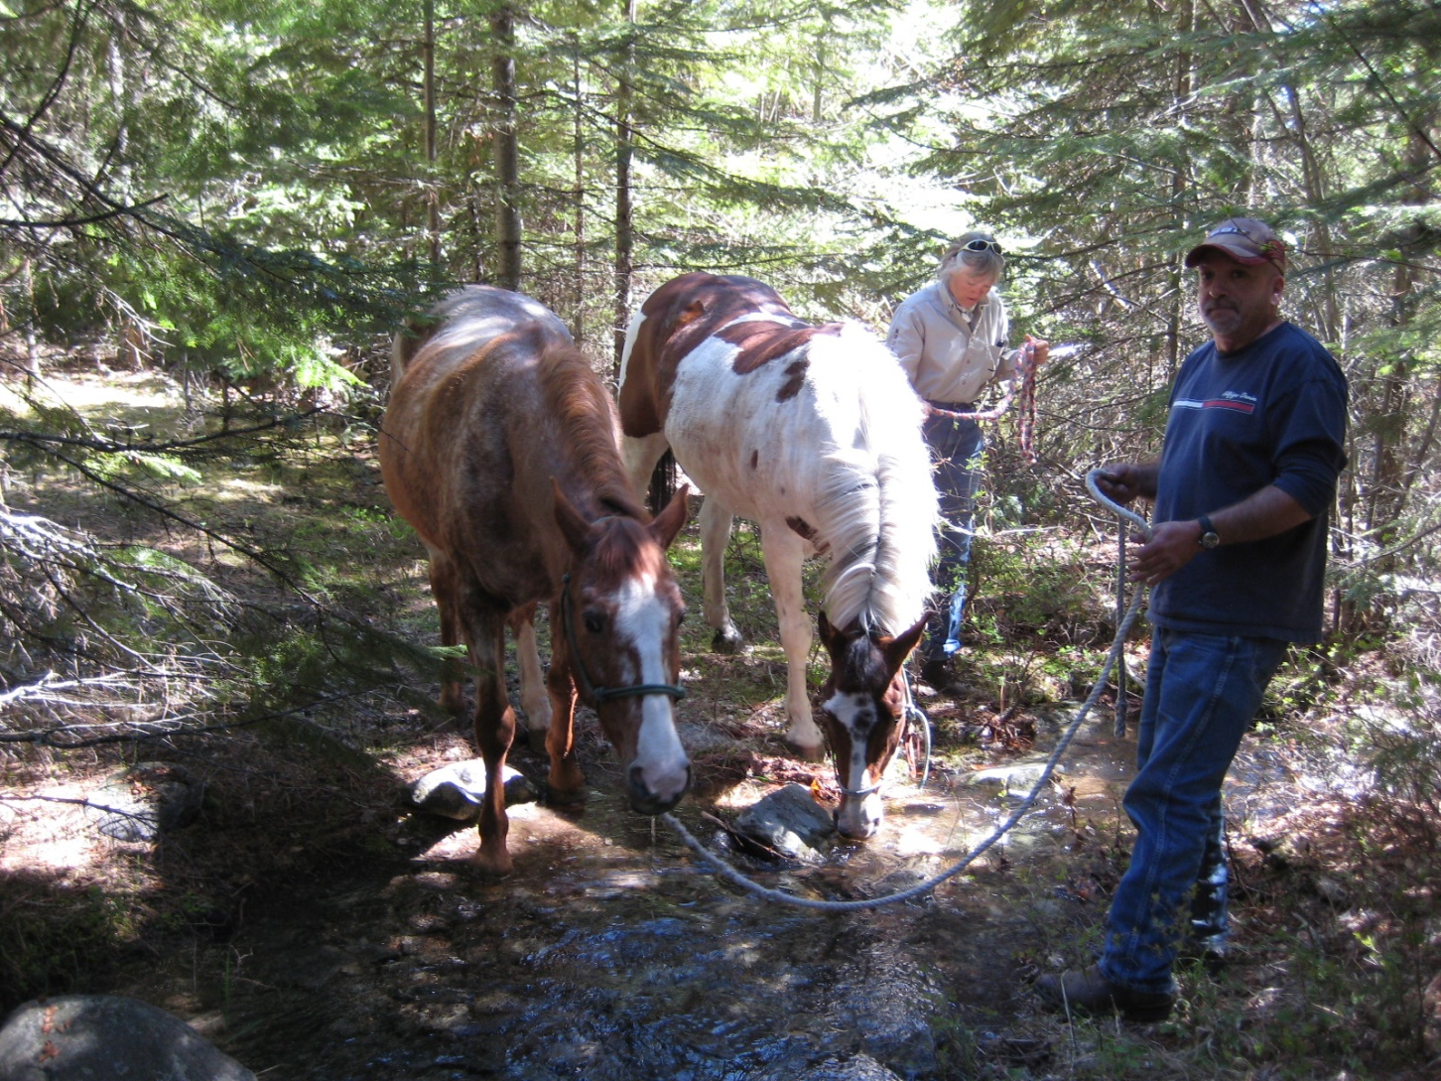
Watering Concerns

Slide 24
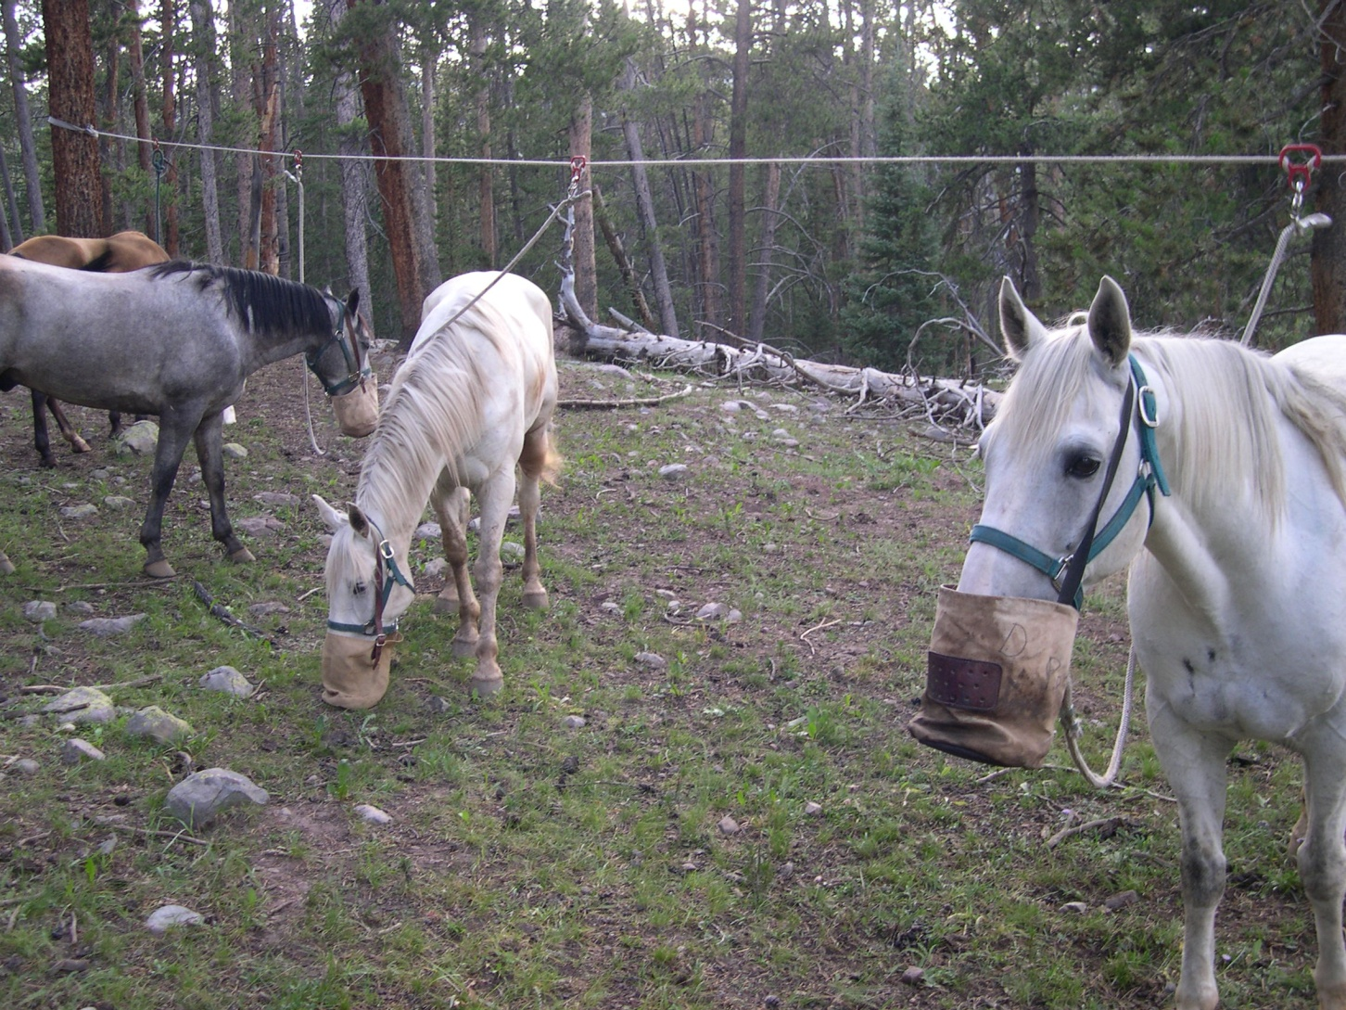
Supplemental Feed

Slide 25
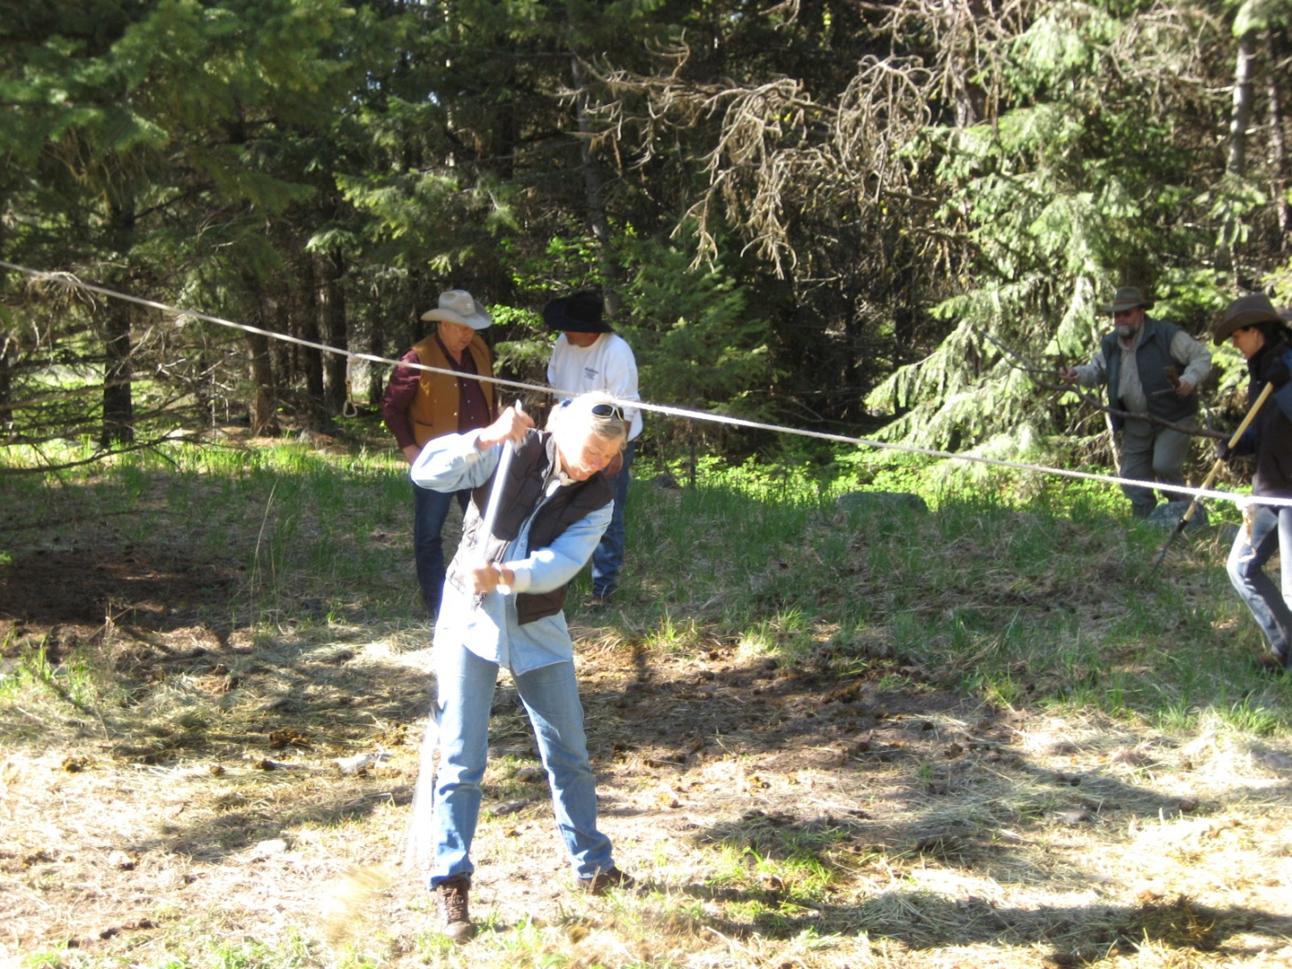
Breaking Camp

Slide 26
Other Equine concerns
Dispose of waste properly:
Pack it in pack it out
Leave what you find
Avoid spreading non-native plants and animals
Certified weed free?
Respect Wildlife
Grazing/feeding
Watering
Season
Be considerate of others
Trail Etiquette
Camp Etiquette

Slide 27
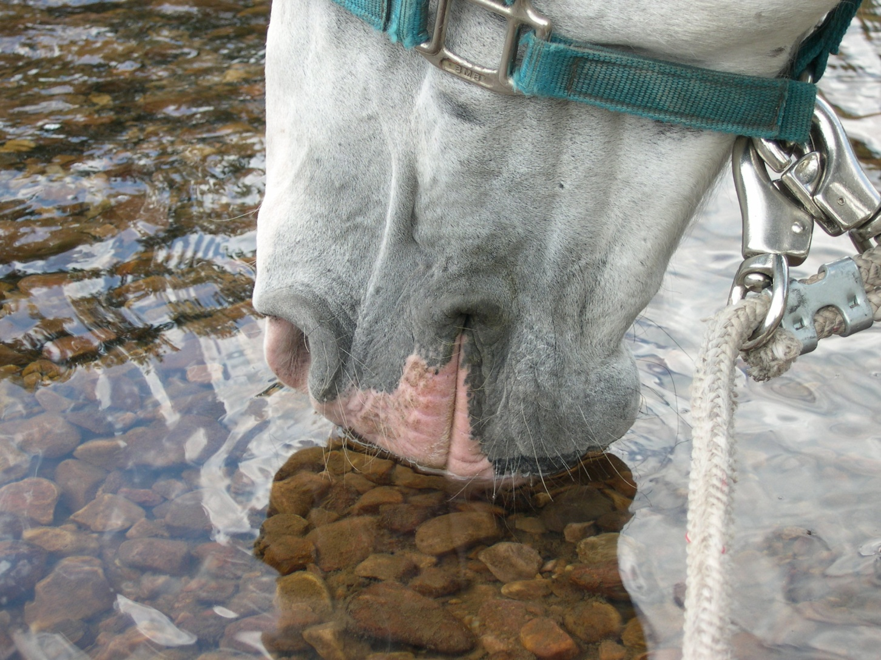
The End

